Slide 1
Microdata for Dallas County Historical & Genealogical Cemetery Data
Tony Hanson
Webmaster

Slide 2
What is Microdata?
A vocabulary and syntax used to extend HTML with additional machine readable semantics

Slide 3
Why is this important?
The way people navigate to a web page has changed….
Search Engines are being used to locate information of interest
We don’t go directly to web sites any more…
We ‘Google it’ first

Slide 4
How are sites ranked in a search?
Where our site appears on the results list depends a lot on what the web crawlers find
Organizing and tagging data in a way that is meaningful to the search engine is very important…

Slide 5
The Problem
The goal of a well designed web page is to make information useful to natural language interpreters
a.k.a. ‘People’
HTML can make it very difficult for search engines to recognize the data structure

Slide 6
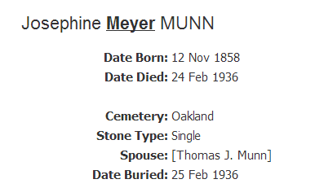
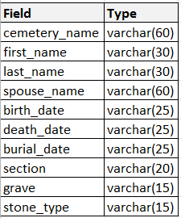
Source: Database

Slide 7
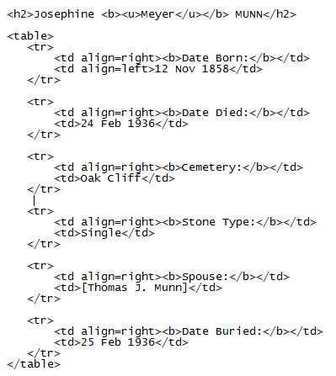
HTML

Slide 8
Dates?

Slide 9
Location?

Slide 10
Names?

Slide 11
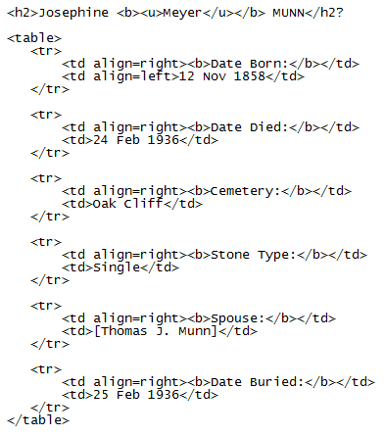
Relationship?

Slide 12
How Does Microdata Help?
Through the use of additional tags, it is possible to identify the specific meaning for each item of information
These tags do not alter the way the information is displayed by the browser
However, they do provide a great deal additional information that can be used by the browser, the web crawlers and other applications

Slide 13
Launched in June 2011 by Bing, Google and Yahoo
Yandex – Russia’s largest search engine – has since signed onto the effort
Goal: To create and support a common set of schemas for structured data markup on web pages
Notes:
Not a new problem….
Microformats (Atom feeds, Contact & Address Information, etc.) came along in 2005
RDFa (Resource Description Framework in Attributes) emerged slightly later

Slide 15
The Type Hierarchy
Thing
CreativeWork
Event
MedicalEntity
Organization
Person
Place
Product

Slide 16
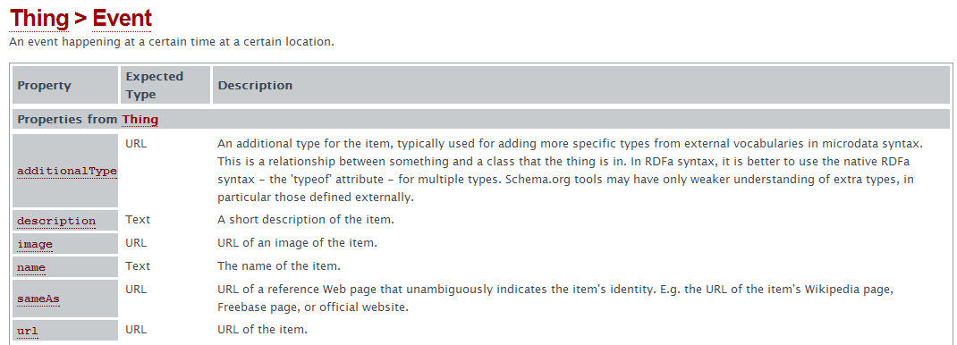
Name
Type
Description

Slide 17
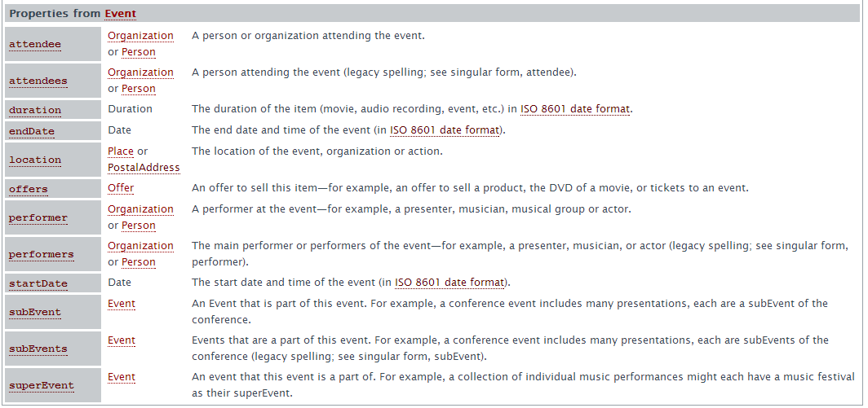

Slide 18
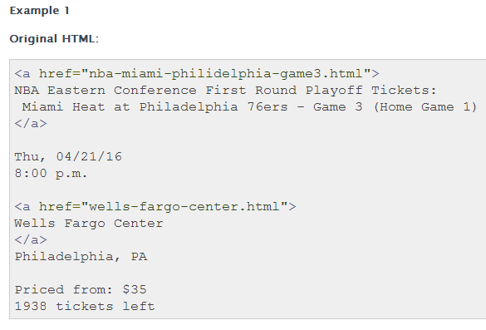

Slide 19
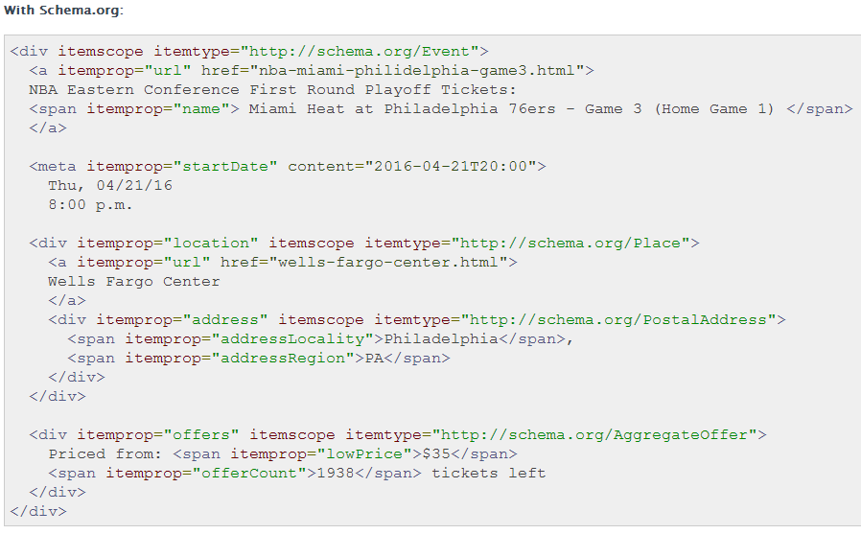

Slide 20
Browser Support
Tagged data is available for any application to use
Google’s Chrome Browser supports extensions
People Inspector
Senses when a page has information tagged using the schema.org People Schema
Does useful things with that information

Slide 21
DGS Cemetery Database
35,000 records
Data gathered by volunteers for 13 years
Sources:
Cemetery Records
Tomb Stones
Other Records
Has been tagged with schema.org schema’s

Slide 22
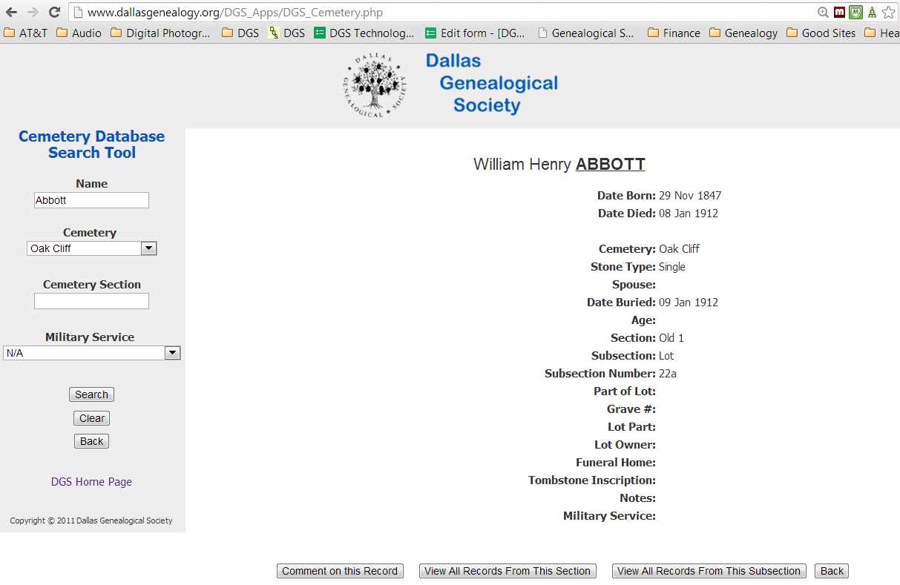

Slide 24
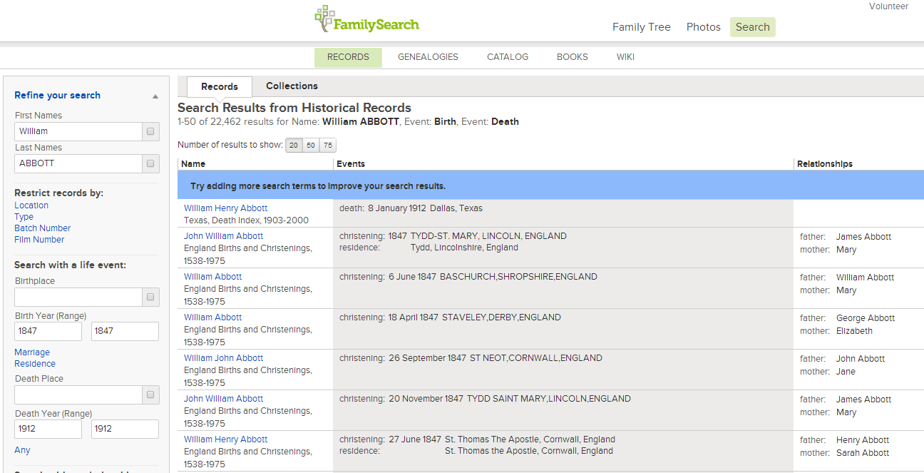

Slide 25
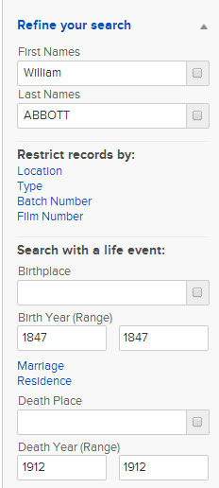

Slide 27
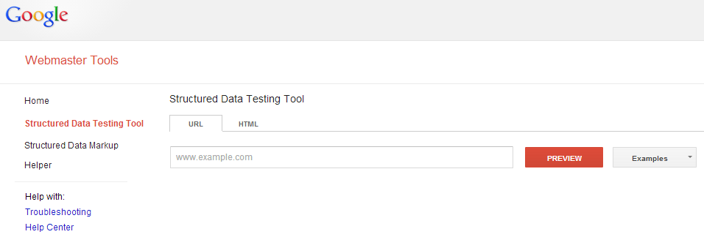
Testing Tools
http://www.google.com/webmasters/tools/richsnippets

Slide 28
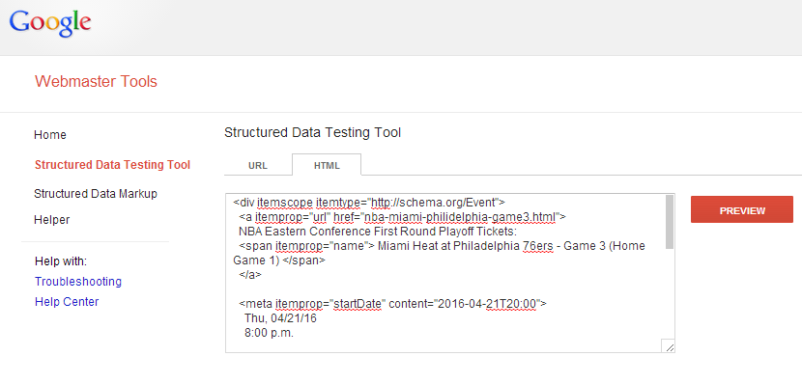

Slide 29
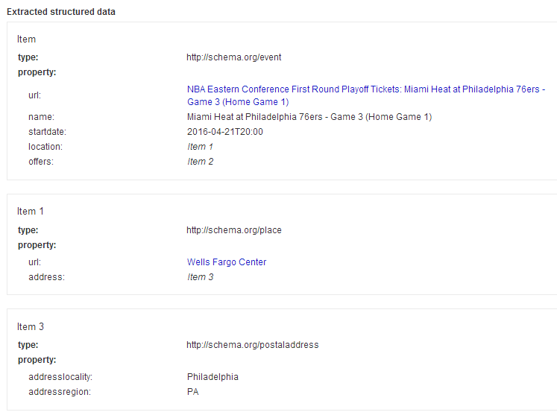

Slide 30
Summary
Microdata provides semantic meaning for your web data
This makes your data more meaningful to crawlers, browsers and other web services
schema.org appears to be the dominant standard for the major search engines
Additional Information: schema.org

